Slide 1
Pathway to Precision:
Strengthening
Clinical Data
Imaging
Juan Pablo Garcia Martinez

Slide 2
What?
Why?
How?
Full automate pipeline
Full life cycle Query tracker
Realistic approach
Dynamic ingestion
One single channel of communication
Dynamic ingestion via profiling
Query automate generator
Tacking system
Visualisation system
Not aggregated data

Slide 3
Data
Quality
Consistency
Accuracy
End Point Improvement
What?
Explore our cutting-edge visualization tool for oncology imaging: a modular solution that refines tumor data analysis and automates query generation for clinical trials…

Slide 4
Why?
Proven Efficiency
Automated pipelines validated by experience, generating thousands of queries for 14 studies, and saving immense manual effort.
Dynamic Solutions over Static AI
Our approach embraces versatility, avoiding rigid AI models, and ensuring meaningful validation.
Enhanced Communication & Consistency
Autogenerated queries synchronize cross-site operations, streamlining workflows.
Traceability & Compliance
Our tracking system offers real-time monitoring of each record, enhancing accountability and compliance by no aggregating data.

Slide 5
How?
Modules:
Data Ingestion: Dynamically connect and ingest data from multiple EDC platforms, achieving standardization through sophisticated profiling.
Calculation: Implementing criteria for theoretical response calculation, matched with robust consistency checks and flagging systems.
Auto-Query: Generate queries with customizable responses, pinpointing and flagging the root of each issue for targeted resolution.
Tracking: Cross-reference current data against historical records to highlight changes, ensuring all past data remains accessible for comprehensive analysis.
1
End Point
Data Ingestion
Calculation
Auto-query
Tracking
4
2
3

Slide 6
Data Ingestion Module 1
Facilitates seamless data integration from diverse sources such as APIs, SFTP, local or cloud storage, and databases. It standardizes data through profiling and checks, consolidating it for consistent processing. Finally, it ensures data integrity before further calculations with comprehensive logging, unification, and crosscheck validation.
Data Connection
API
Data Standardization
Profiling
Pre-Calculation Output
Logging
Local Files
Local Database
SFTPs
Cloud Storage
Ingestion Checks
Consolidation
One Single Source
Crosscheck Validation

Slide 7
Calculation Module 2
The Calculation Module efficiently progresses from user-defined data rounding to field calculations, parameter computations, and response analysis, culminating in stringent consistency and logic checks to ensure accuracy and reliability.
Rounding (Set by user)
Various Logic Checks
Response/Overall
Response Calculations
Consistency Checks
Calculated fields
Parameters calculations

Slide 8
Auto-Query Module 3
Data Ingestion, Calculations and Matches
Essential for data integrity in automated systems
Detects discrepancies such as:
Missing mandatory forms or fields
Duplicate records
Response/Overall response assessment errors
Intelligently generates queries to address these issues
Ensures data meets required standards for:
Quality
Completeness
Adds significant value by:
Minimizing errors
Maintaining high data accuracy
Facilitates informed analysis and decision-making in subsequent processing stages
Data Validation
Query
Consistency Checks
Query
Response Check
Query
Overall Response Check
Query
Advance Checks
Query
Criticality Score

Slide 9
Auto-Query Example
Criticality Score
Auto-Query Generated
Non-Critical
Attention Required: For Subject XXXX at timepoint Week XX, there are 3 target lesions recorded at the same location. RECIST 1.1 guidelines permit a maximum of 2 target lesions. Please verify the data and adjust accordingly to comply with the RECIST 1.1 standards.
Non-Critical
Query Notification: Subject XXXX at timepoint Week XX has a lesion entry without a specified location.. To ensure accurate system execution and compliance with evaluation protocols, please confirm and provide the missing location details
Critical
Query Alert: Stable Disease (SD) has been logged for Subject XXXX at the Week XX assessment. Yet, the total sum of lesion diameters indicates an 27% increase, with a change in size of 13mm from nadir, suggesting a Potential Disease Progression (PD) as per RECIST criteria. Please reassess the data and rectify as necessary to align with RECIST response categories. This has a direct impact in the Overall Response and hence on the end point
Warning
Data Review Required: For Subject XXXX at the Week XX assessment. The recorded value significantly deviates from established trends and expected ranges, this may indicate a measurement error or an anomalous data point. Please re-evaluate the measurement to confirm its accuracy or provide additional context.

Slide 10
Tracking Module 4
This module evidently tracks the data from output and calculation, including query generation, moves it into archival storage, performs crosschecks between current and historical (legacy) data, and updates the status field to reflect new, edited, or unchanged data, keeping a record of previous values for reference. It's a comprehensive solution for overseeing data integrity and history.
Output + Calculation + Queries
Archival Storage
Crosscheck between Current and legacy data
New Status field
New/Edited/Static
Previous values

Slide 11
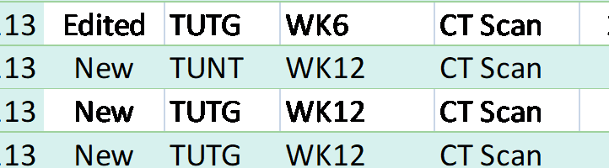
Tracking Example
Status Flag
Comment
Example
New
The record/field is being ingested for first time in the platform.
Edited
The record/field is being edited since the last time data was ingested in the pipeline. Previous value is available.
Previous value (Date): Stable Disease
Static/NA
The record/field is being already ingested and not changes have been detected.
Note: This module is essential for monitoring the status of each record in real-time. It enables the sequential addition of data, effectively illustrating the complete cycle of data management. This feature is particularly useful for resuming work exactly where we left off, maintaining the continuity and efficiency of our processes.

Slide 12
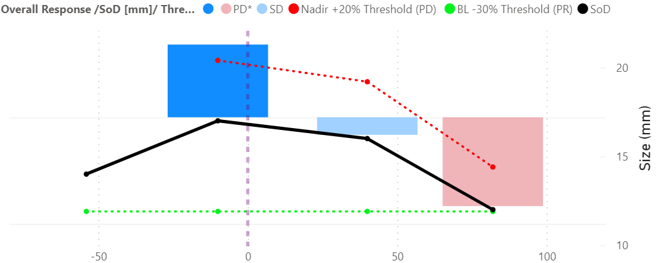
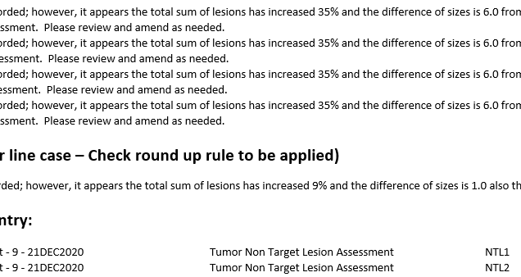
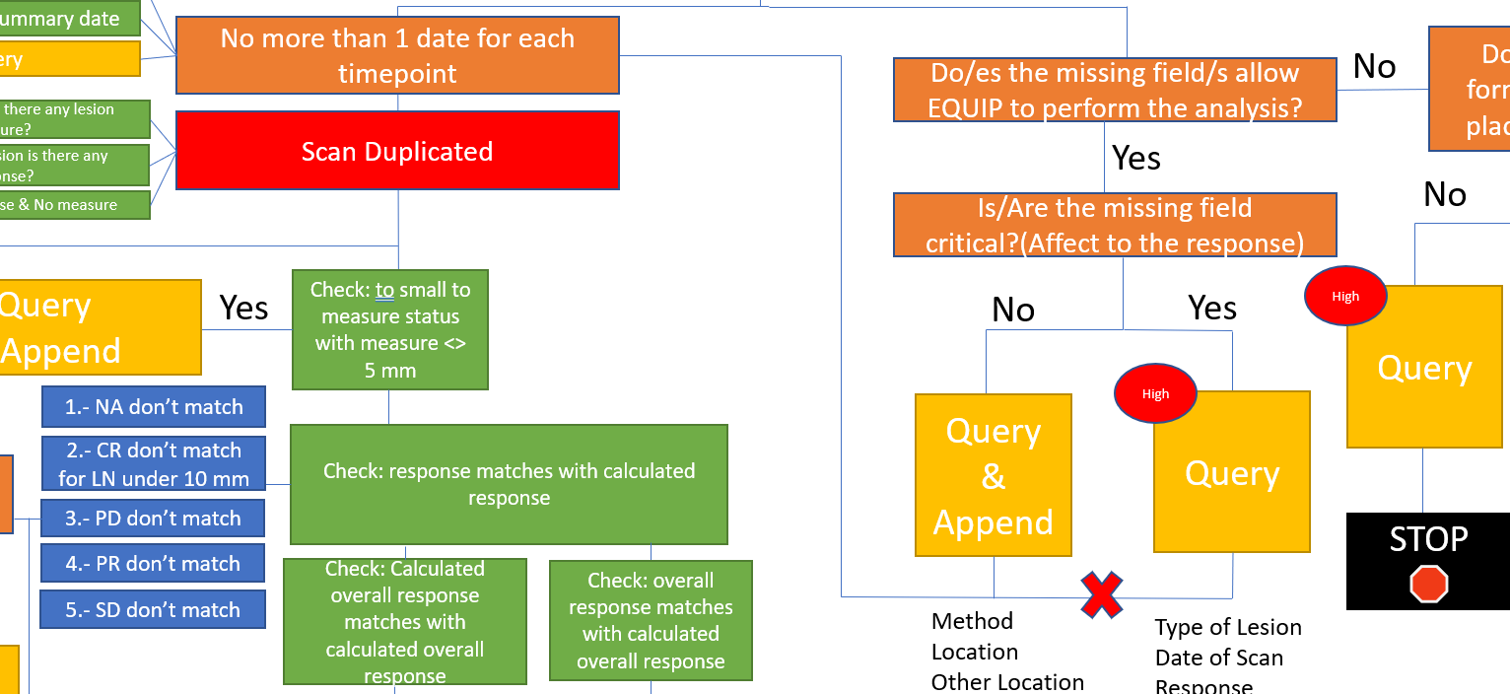
Outputs/Reports
Data Visualization Tool:
Integrates Standardized Criteria with exploratory analysis for enhanced data interpretation.
Provides a detailed, subject-centric view to support targeted decision-making.
Facilitates comprehensive Safety Reviews with data-driven insights.
Customized Reporting:
Flags issues and generates queries efficiently, focusing only on areas of concern.
Ensures rigorous compliance with clinical trial protocols and standards.
Streamlines workflows, significantly reducing review and correction times.
Integrated Query System:
Automates query dispatch to study sites for prompt issue resolution.
Employs a robust monitoring system to track the volume and status of queries.
Offers complete Life Cycle Study monitoring, from initiation to closeout

Slide 13
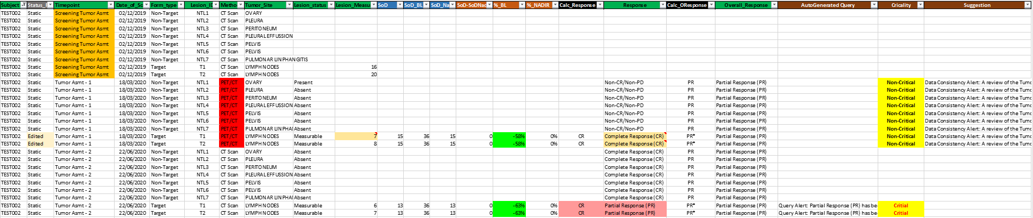
Outputs/Reports
Appending Method: All reports are appended in their entirety. This includes data from Target, Non-Target, and New Lesion reports without the application of any filters. Record Generation: Each record is uniquely generated and identified by a combination of Subject, Timepoint, and Lesion ID. All pertinent calculations are applied specifically at this granular level, ensuring the tool's compliance by avoiding any aggregated data analysis. Query Identification and Criticality: The tool is equipped to pinpoint queries that might significantly affect the Overall Response, which are integral to the trial's potential endpoint. Such queries are flagged as critical for immediate attention. Consistency Checks: The tool conducts thorough background consistency checks to ensure data integrity. Any discrepancies detected during this automated process are flagged for review. Customizable Query Text: The query text generated by the system is coded with the ability to be edited, allowing customization to meet specific user or study requirements. Customize Report: The tool can generate a Customize Report only showing the error/flags that have been detected or automatically send the query.
Disclaimer: The data presented is generated through a synthetic process and should be used for simulation and system testing purposes only.

Slide 14
Revolutionizing Clinical Data Analysis with AI-Driven Precision
Synergistic Data Exploration: Seamlessly merge exploratory analysis with standardized criteria to illuminate deeper insights in clinical data.
AI-Powered Query Generation: Harness real AI value by automatically resolving non-critical queries, optimizing data accuracy in areas such as:
Outlier detection
Unit conversions
Tumor Growth Kinetics (TGK)
Genetic markers interpretation
Comprehensive Criteria Suite: Access a versatile array of criteria and protocols, customizable for diverse study needs, including but not limited to:
RECIST / RECIST 1.1 / iRECIST / irRECIST
Lugano Staging Classification and others
Innovative RECIST combinations for multifaceted analysis
Cross-Domain Application: Leverage this groundbreaking tool beyond standard uses, bringing harmony and standardization to the entire eCRF spectrum, enhancing checks across studies, and fortifying safety trackers.
Labor-Saving Methodology: Proven to generate thousands of queries and save immeasurable hours of manual labor, this method is a testament to the transformative power of smart, automated systems in clinical research.
Advanced DICOM Feature Extraction: Utilize cutting-edge automated pipelines for efficient extraction of DICOM imaging features, enhancing data analysis and streamlining workflows.

Slide 15
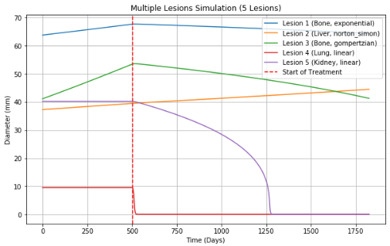
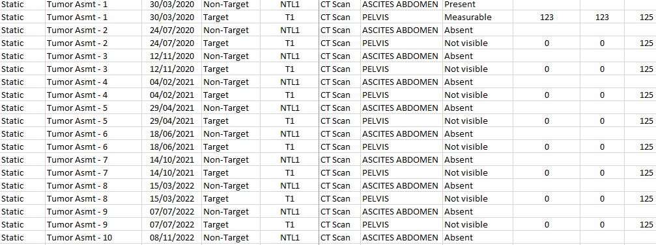
Innovative Synthetic Data Generator: Pioneering Implementation and Analysis
Pipeline Acceleration: Elevates pipeline development and implementation speed, enabling faster go-to-market and iteration cycles.
Pre-Data Deployment: Operates effectively in pre-data ingestion phases, allowing for comprehensive system testing and validation without the need for real patient data.
Comprehensive Coverage: Designed to simulate all conceivable scenarios and implementations, ensuring robust system preparedness.
TGK-Based Modelling: Utilizes Tumor Growth Kinetic models to generate realistic and varied synthetic datasets, enriching testing environments.
Reverse Engineering Capability: Sophisticated algorithms can reconstruct synthetic raw data from desired end-points, facilitating deeper insights and predictive model tuning.
Test Case Generation: Produces a suite of negative and positive test cases, crucial for system verification and ensuring a broad spectrum of scenario testing.

Slide 16
Thank You!

